Slide 1

CS860: Artificial Intelligence
Lecture # 1: Introduction to AI Instructor: Dr. Soyiba Jawed
(slides adapted from Dan Klein, Pieter Abbeel, Anca Dragan, et al.)

Slide 2
Course Format
Course Outline
Available on LMS
Office Hours
Monday 10:00 am – 12:00 am
Tuesday 4:00 pm – 6:00 pm
Also, Available on email

Slide 3
Course Format
Assessments
Quizzes
Assignments &Projects
Mid Term and Final Exam
Assignments and Projects
Theoretical, conceptual, coding based
Project
Apply AI techniques on a problem dataset of your interest
Group of 2 students or one student

Slide 4
CS-860 Artificial Intelligence
Welcome to a fun, but challenging course
Goal: Learn about Artificial Intelligence Increase AI literacy (it’s not magic)
Prepare you for topics courses
Broad coverage of topics
NOT a current events class
LMS
Enrolment Code: 489732506
Email: soyiba.jawed@ceme.nust.edu.pk

Slide 5
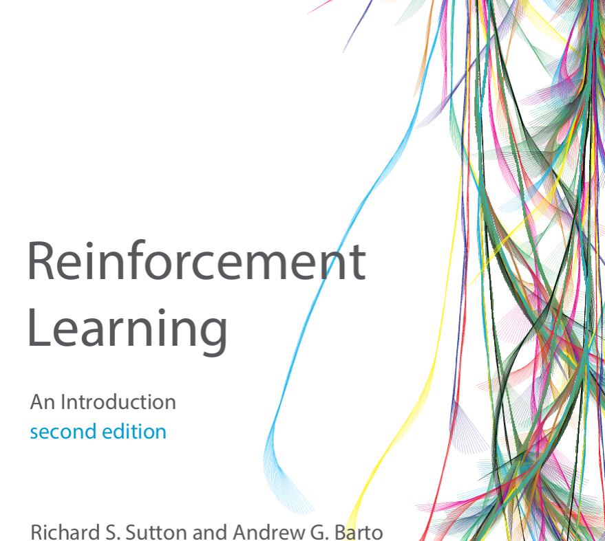
Text book
Artificial Intelligence: A Modern Approach, by Stuart Russell and Peter Norvig, 4th Edition, Pearson, 2020
Reinforcement learning: An introduction
Sutton &Barto

Slide 6
Today’s Class
What is Artificial Intelligence?
A Brief History
Ethical Aspects of AI
Biases

Slide 7
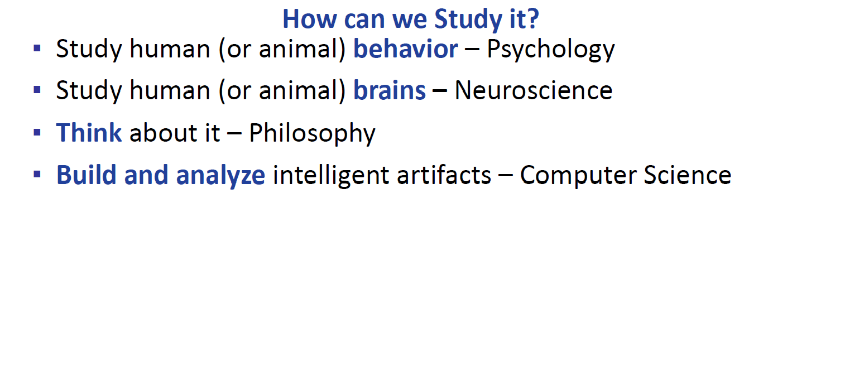

Slide 8
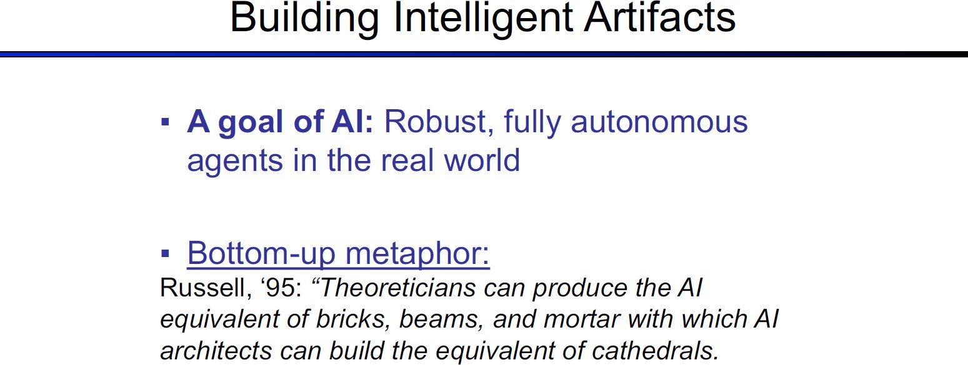

Slide 9
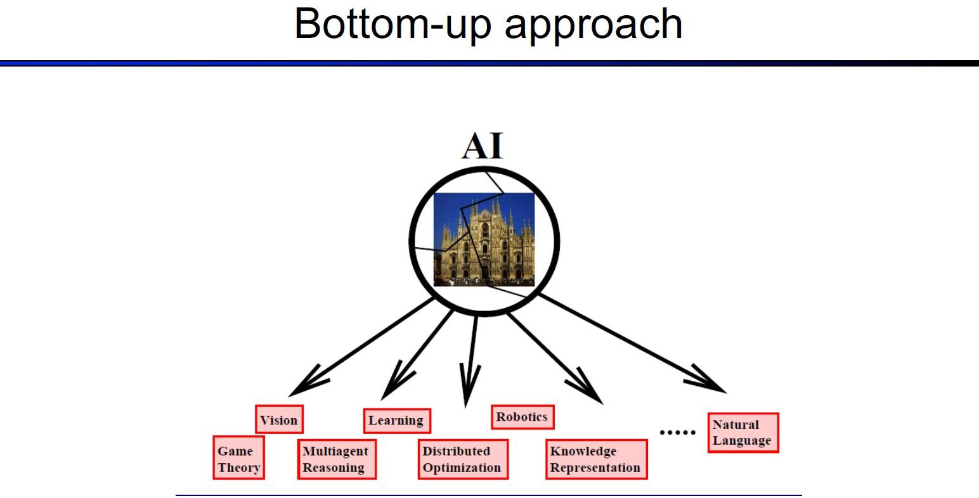

Slide 10
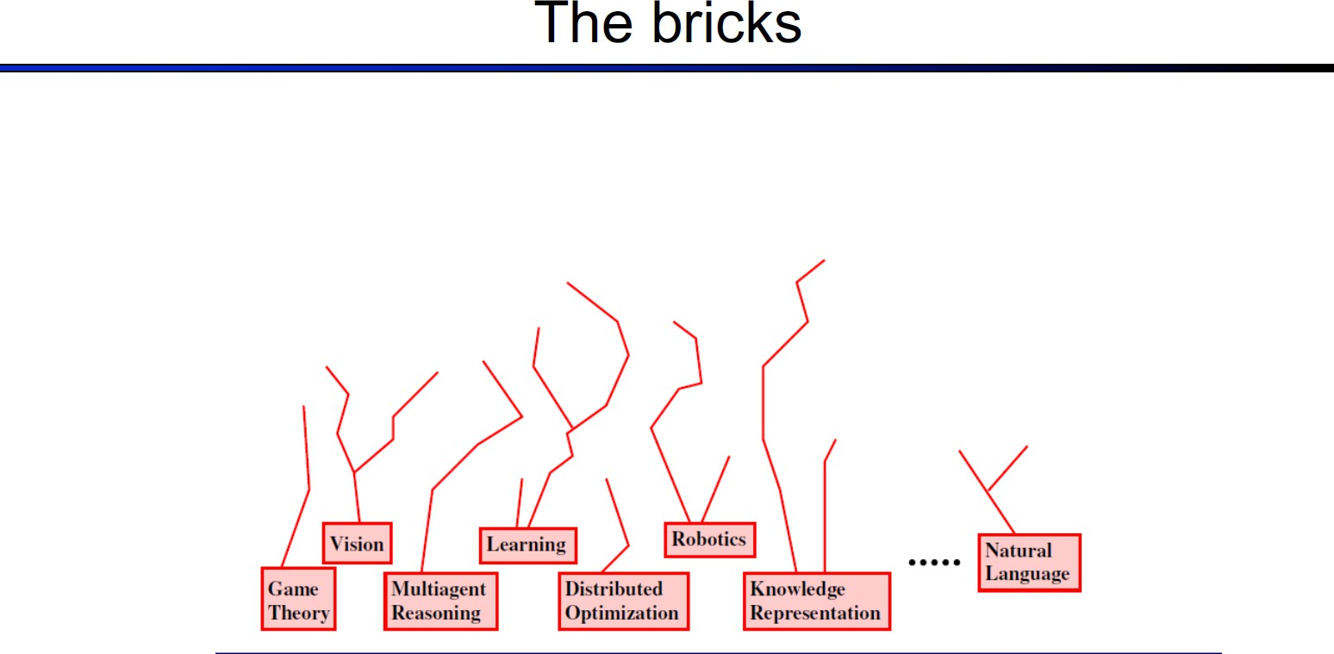

Slide 11
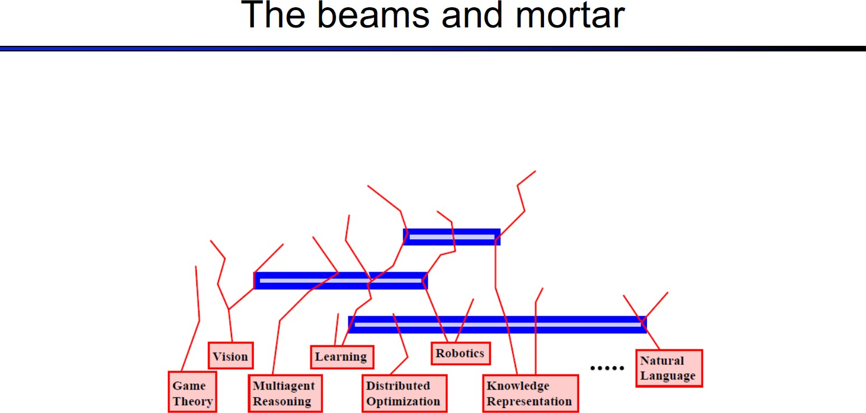

Slide 12
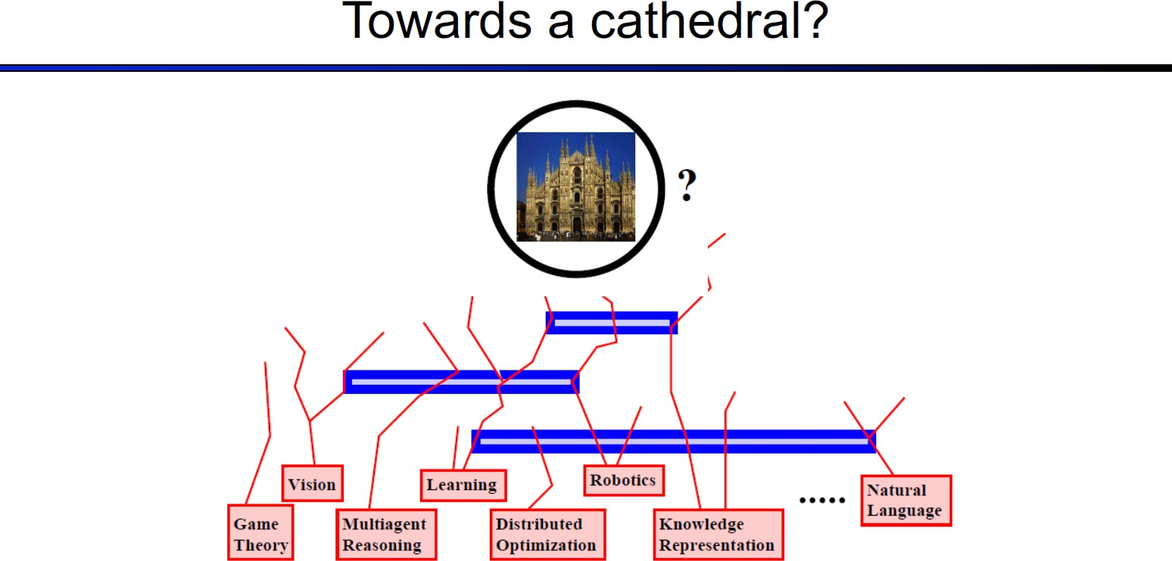

Slide 13
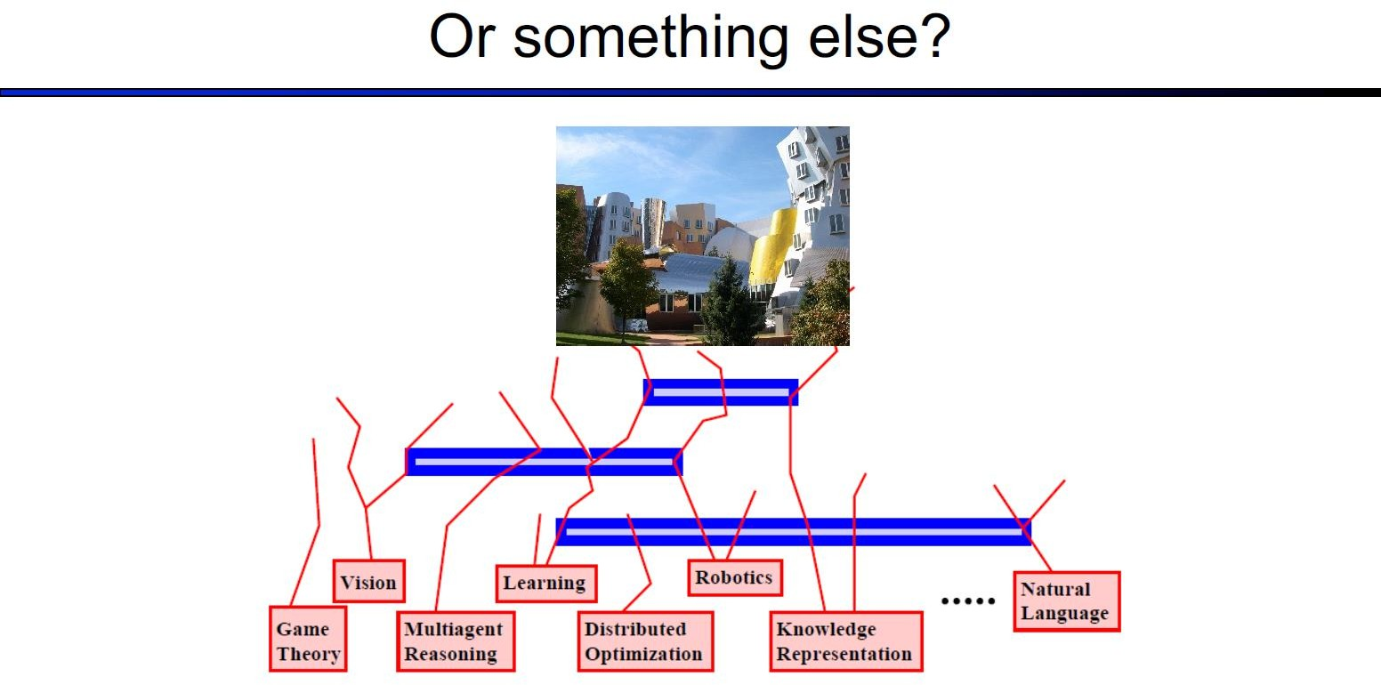

Slide 14
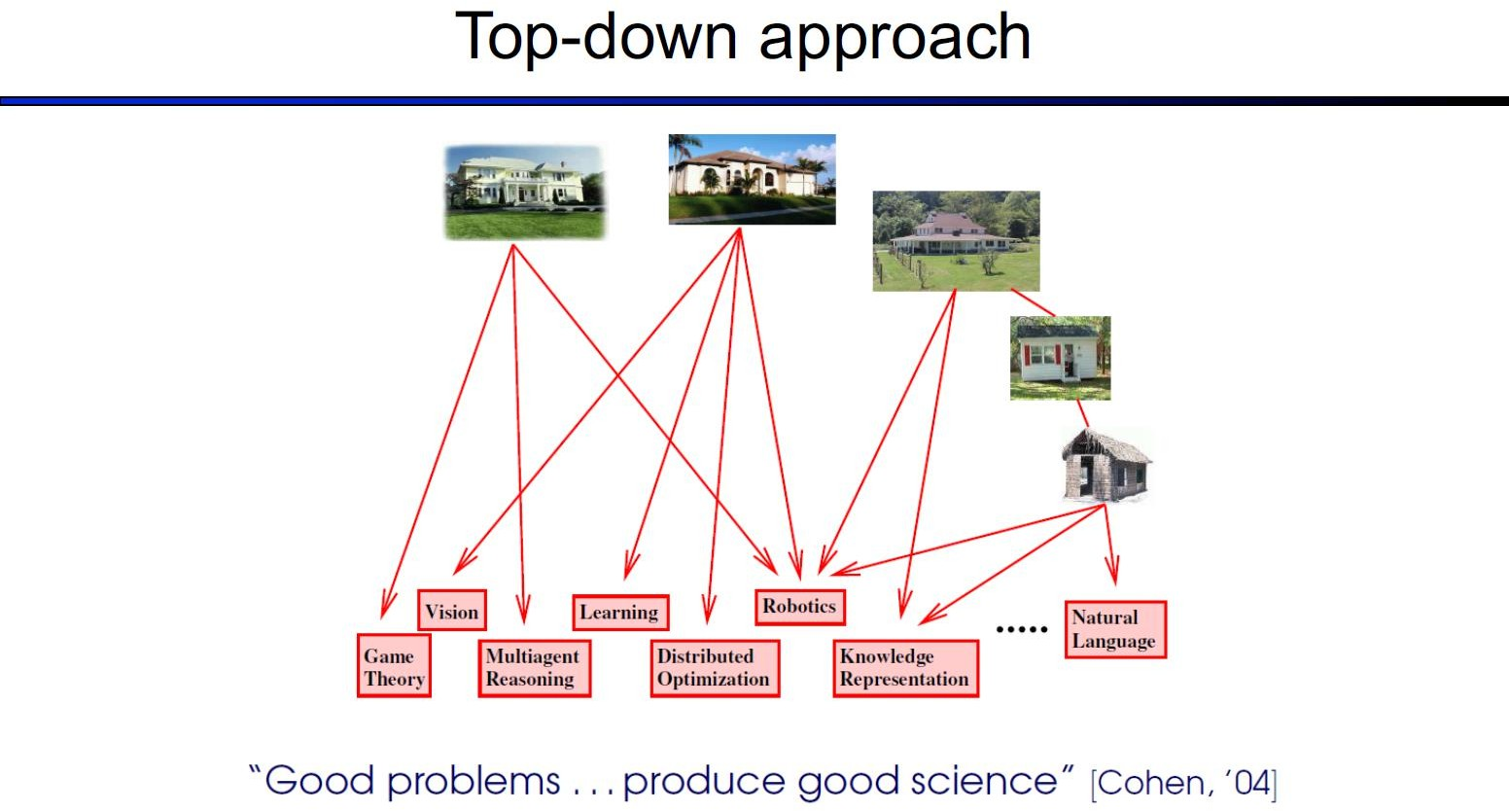

Slide 15
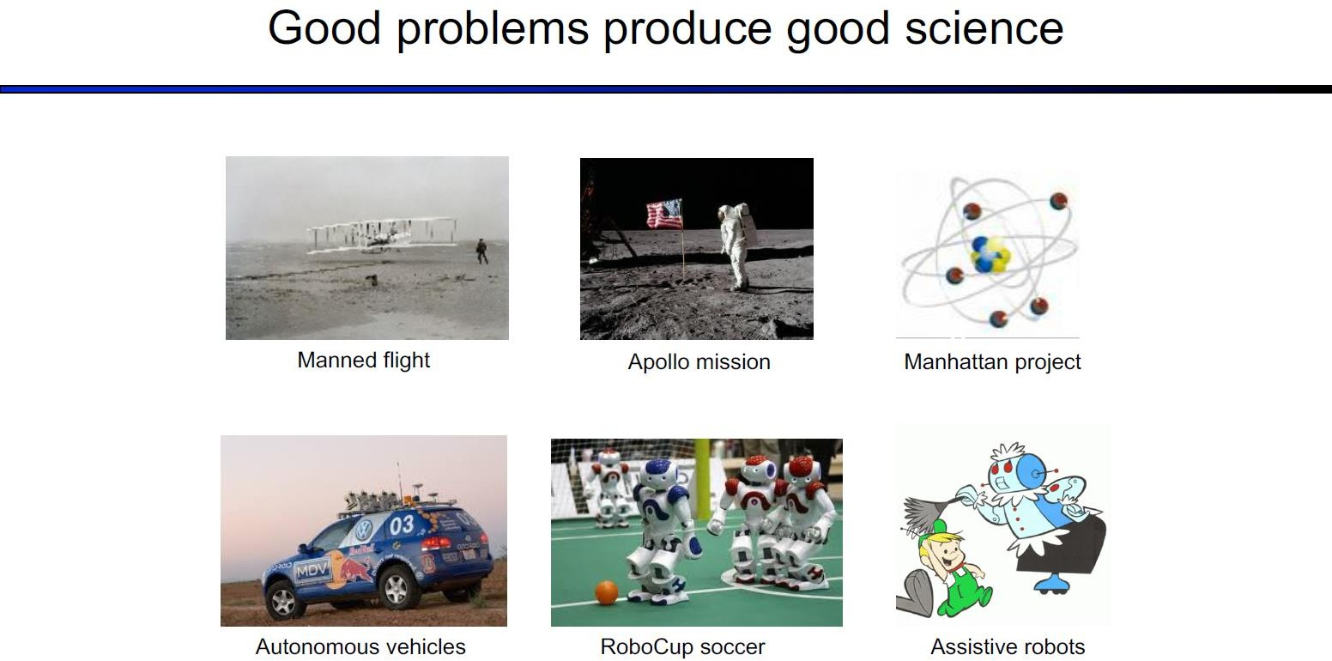

Slide 16
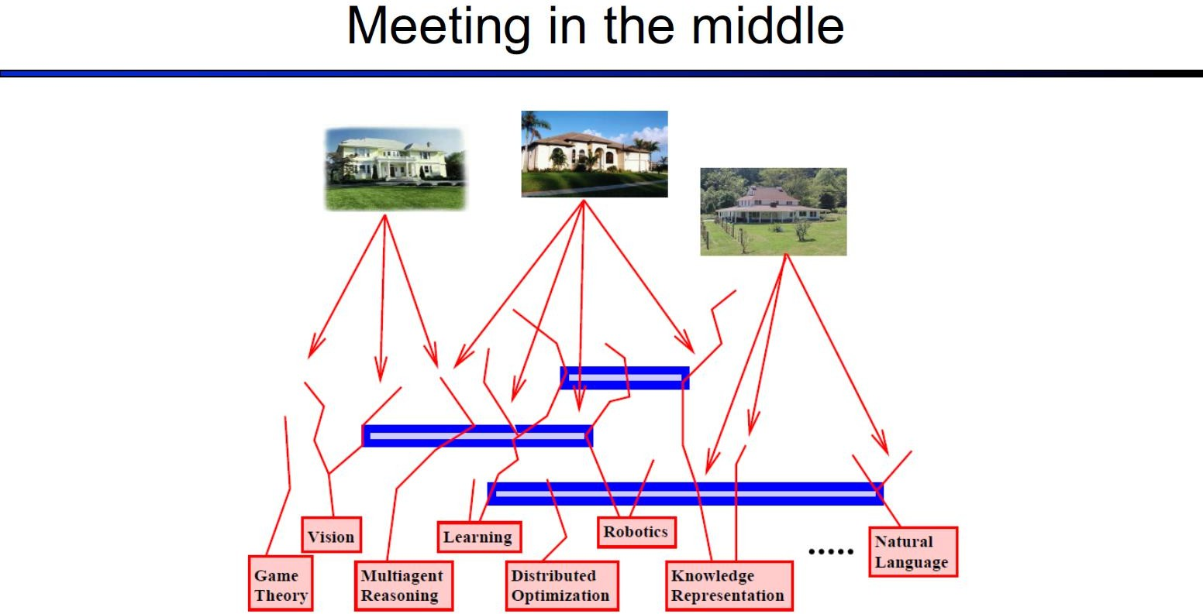

Slide 17
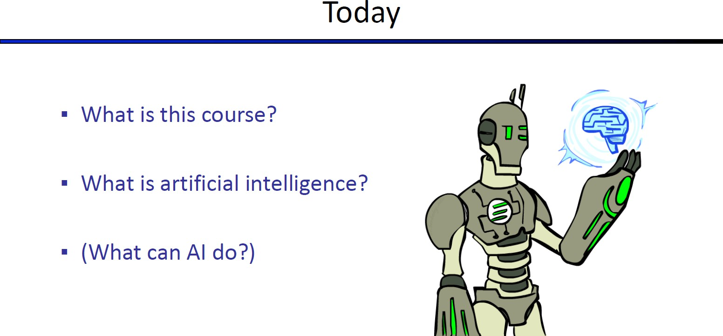

Slide 18
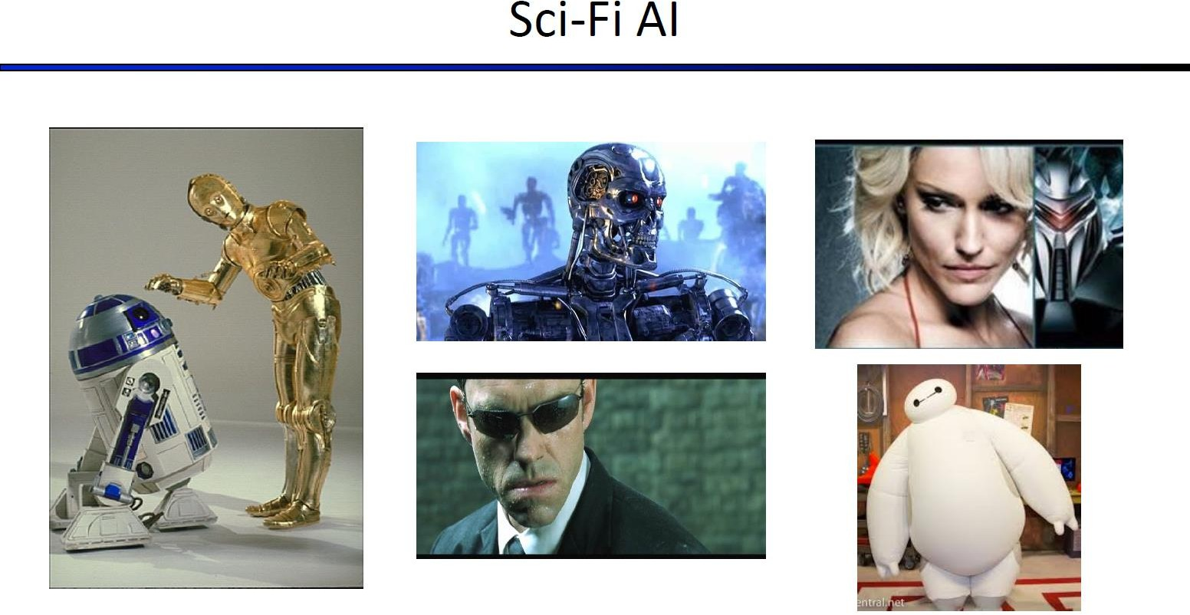
See-Threepio and R2 D2

Slide 19
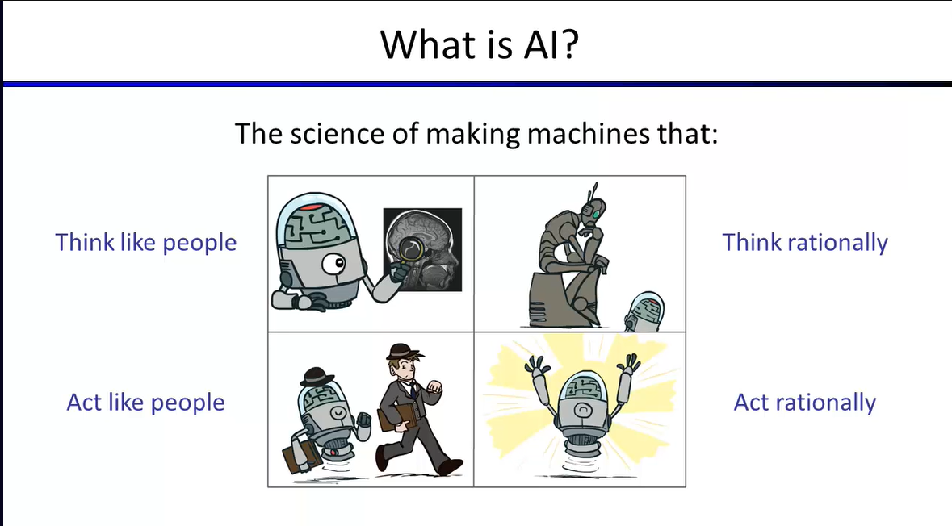

Slide 20
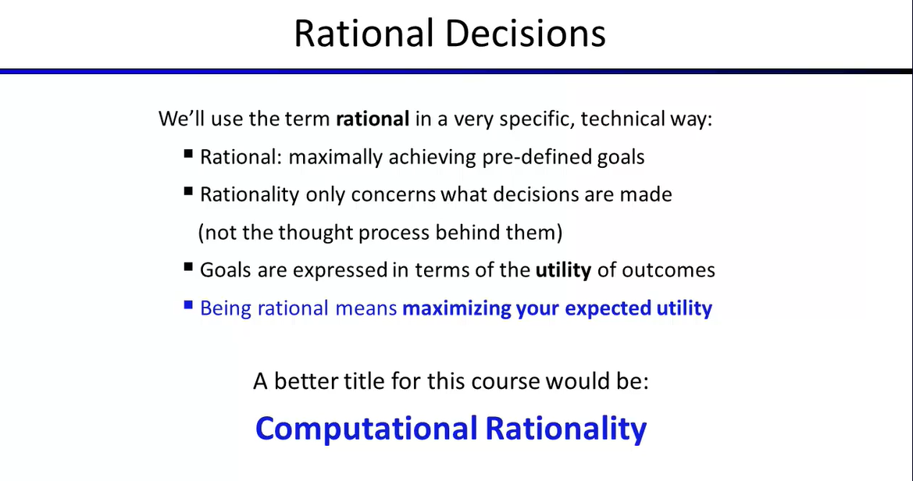

Slide 21
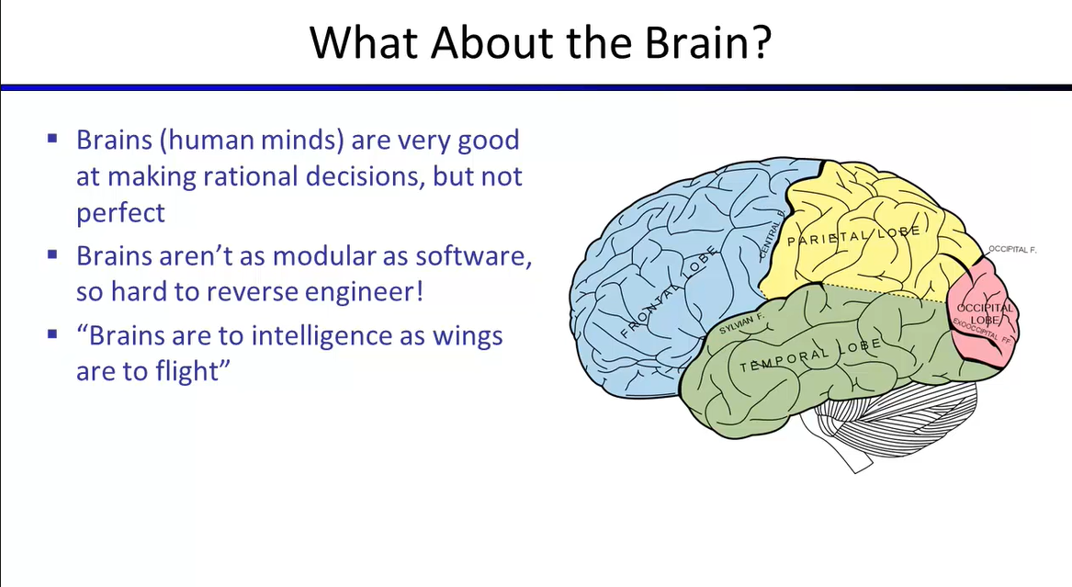

Slide 22
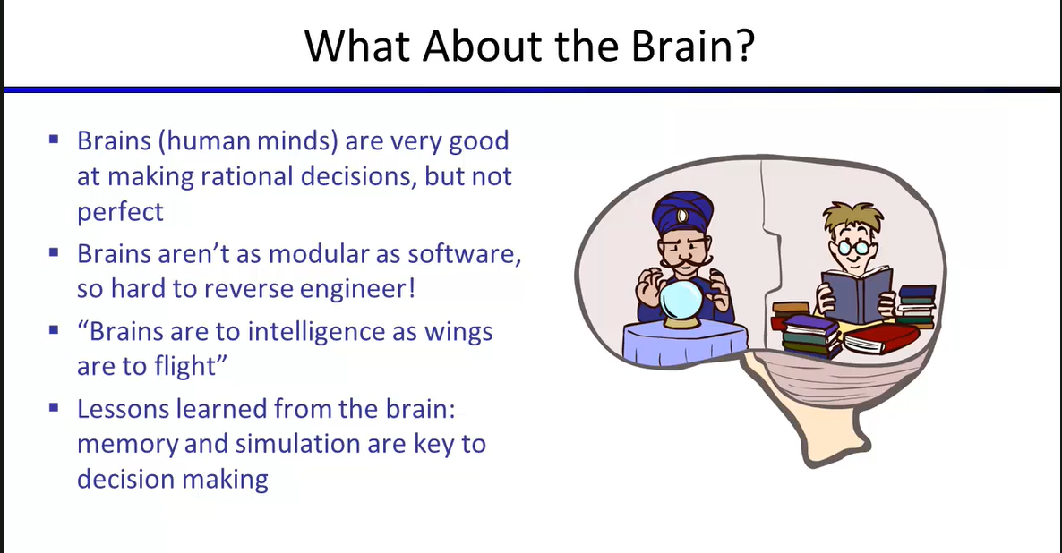

Slide 23
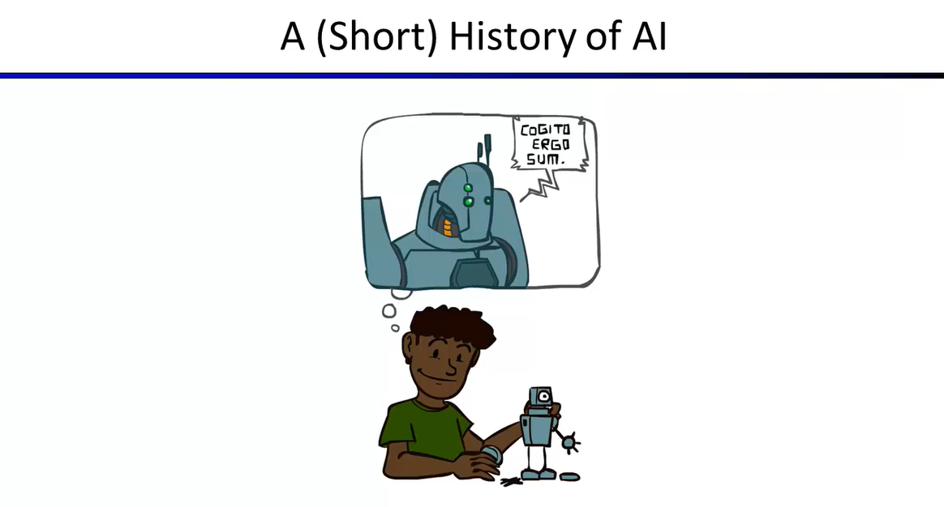

Slide 25
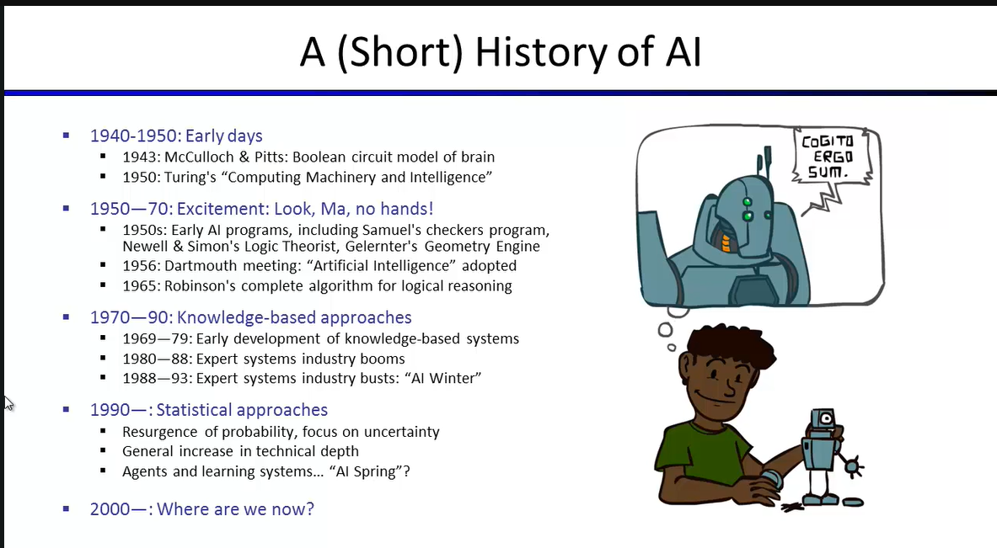

Slide 26
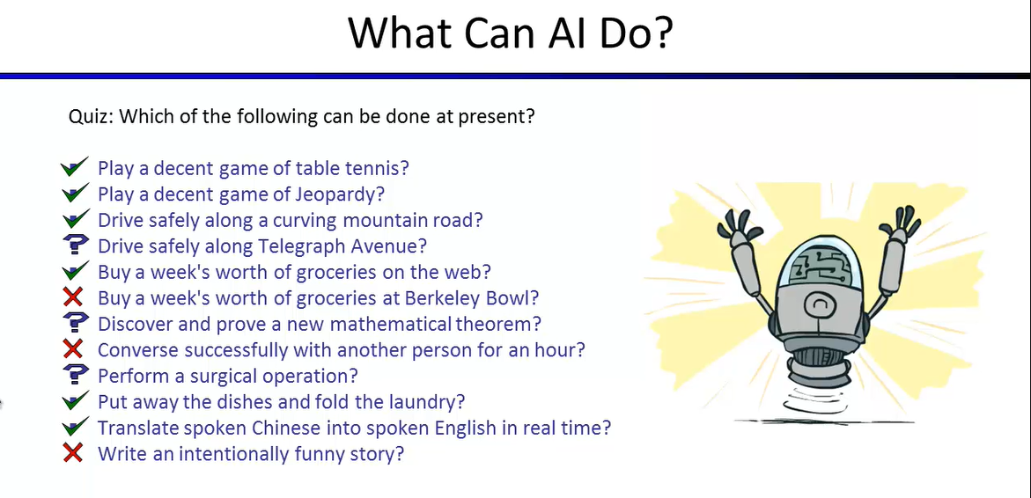

Slide 27
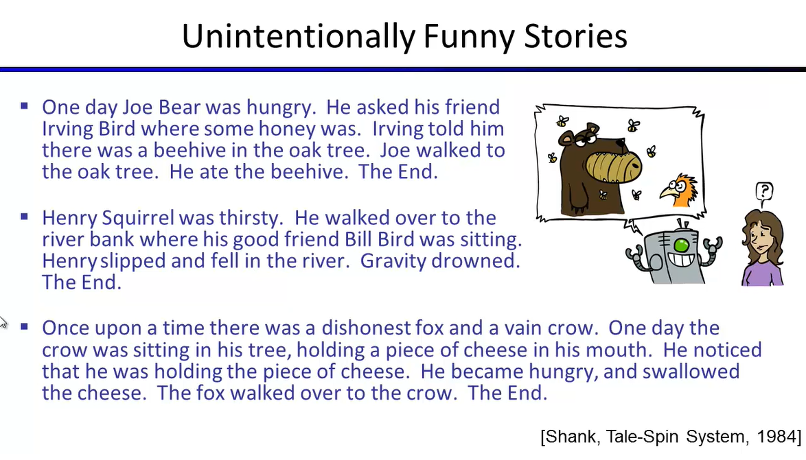

Slide 28
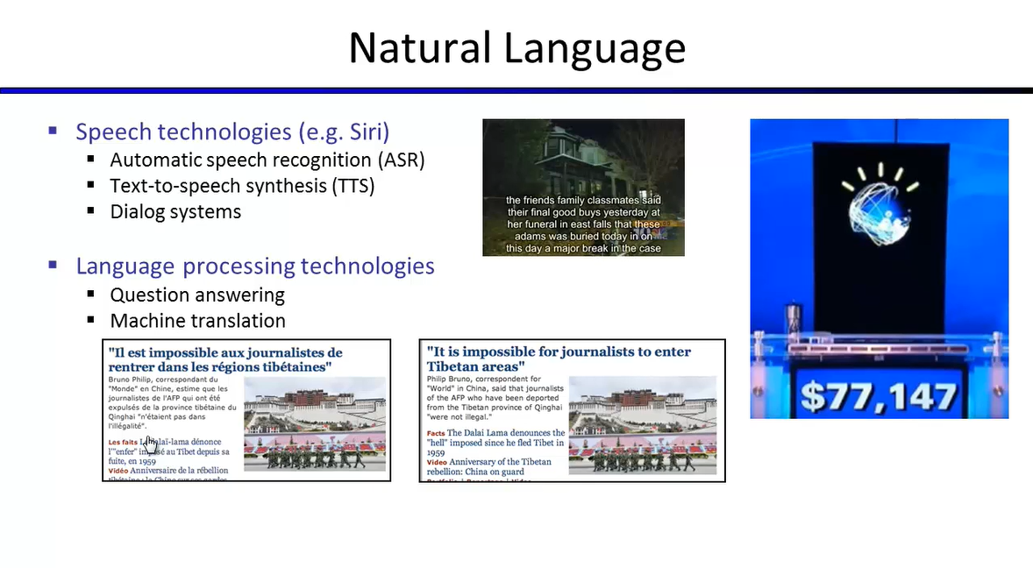

Slide 29
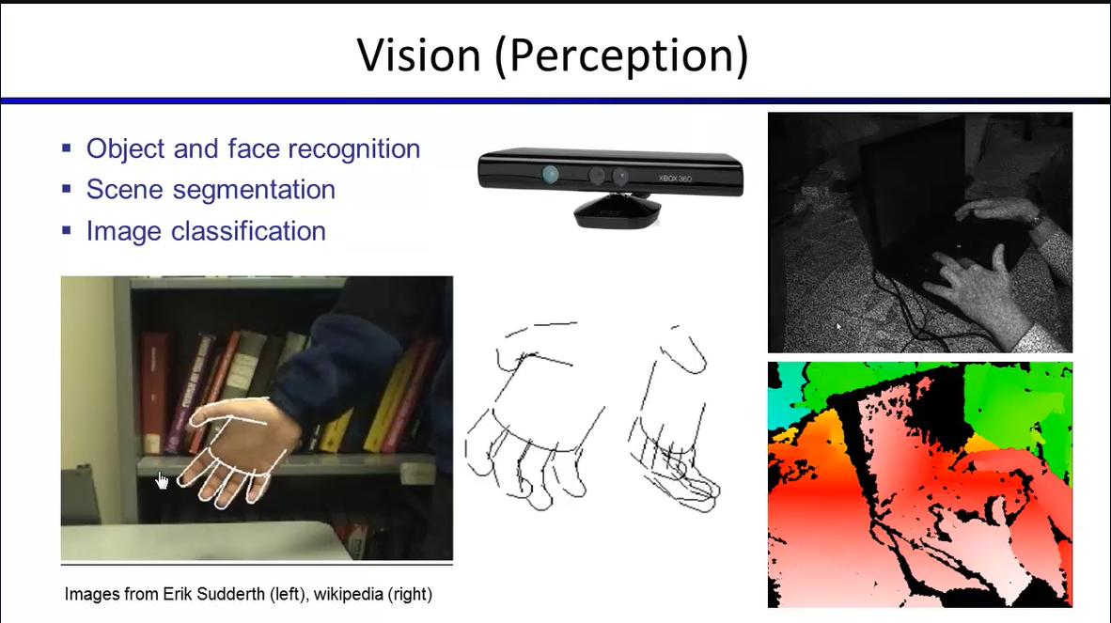

Slide 31
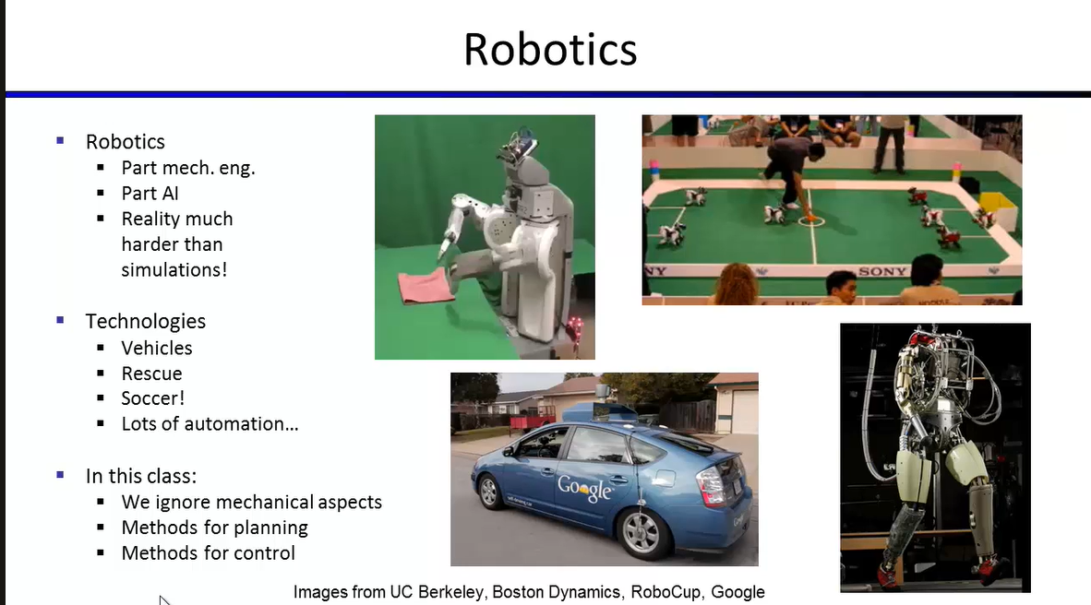

Slide 38
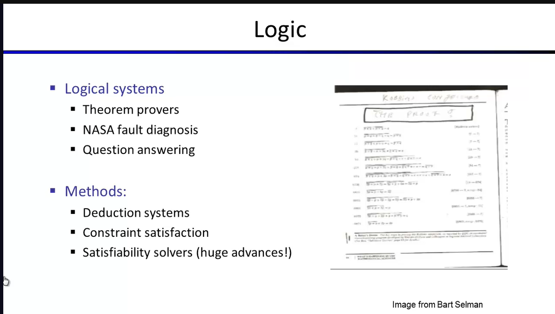

Slide 39
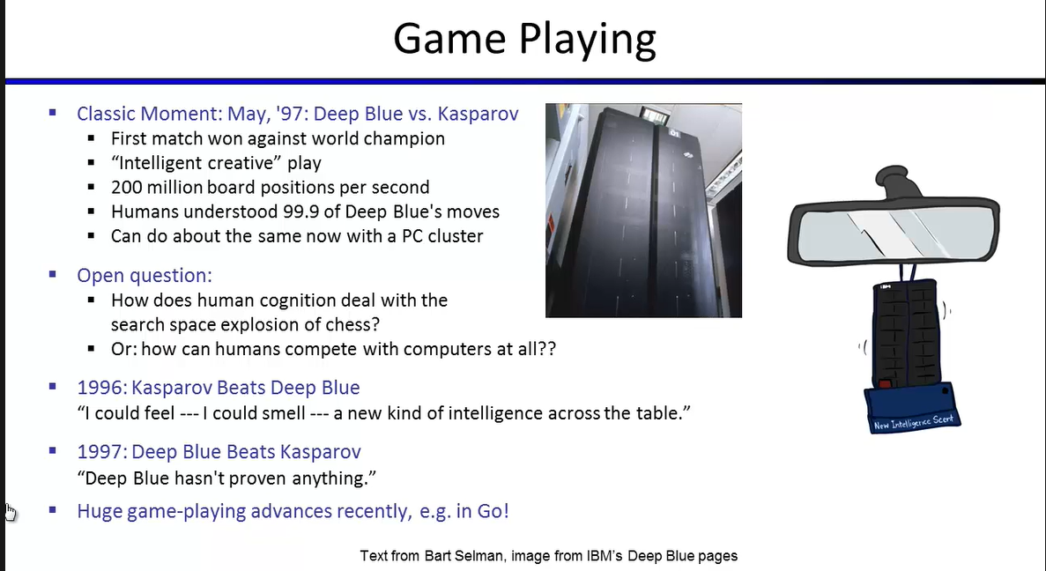

Slide 40
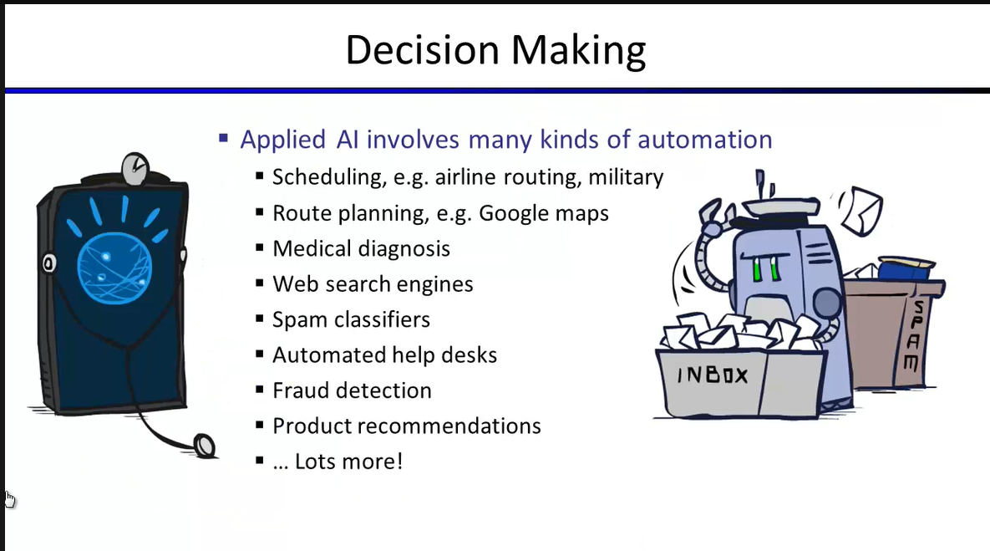

Slide 41
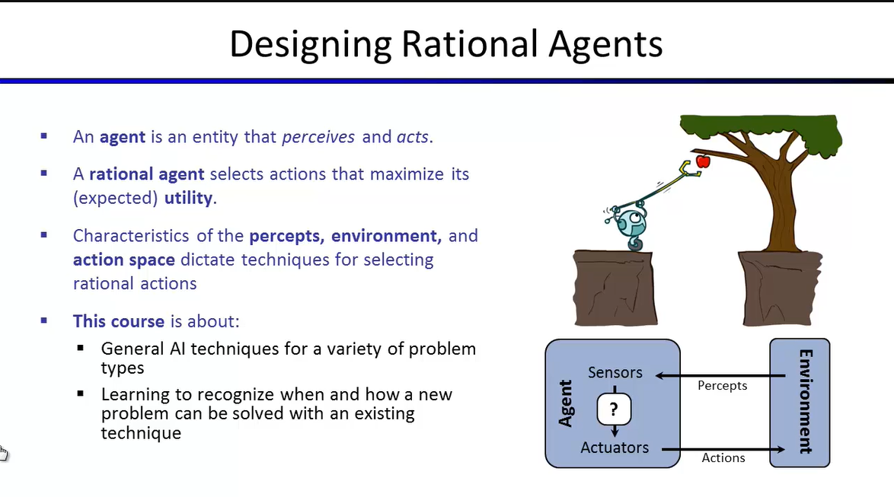

Slide 42
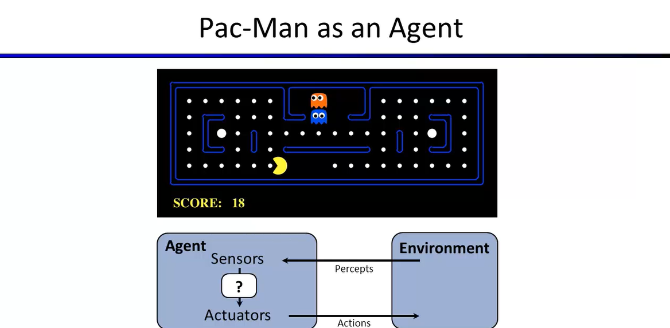

Slide 44
AI: Ethics and Society

Slide 45
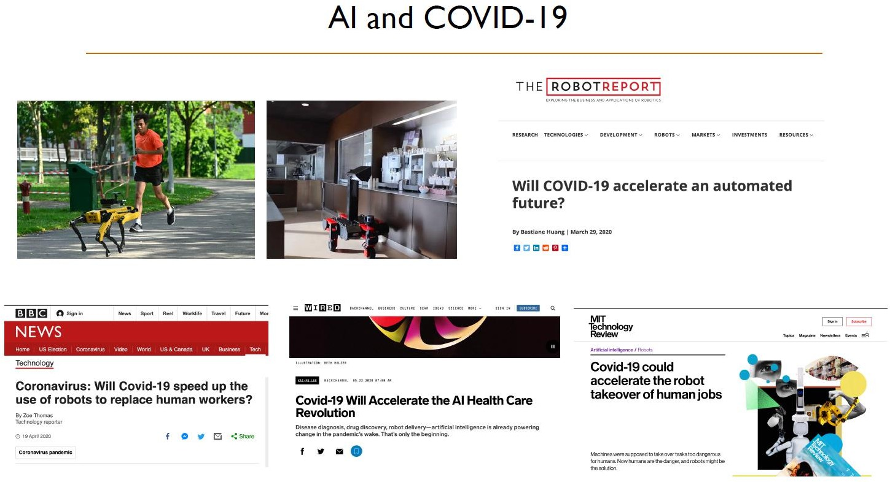

Slide 46
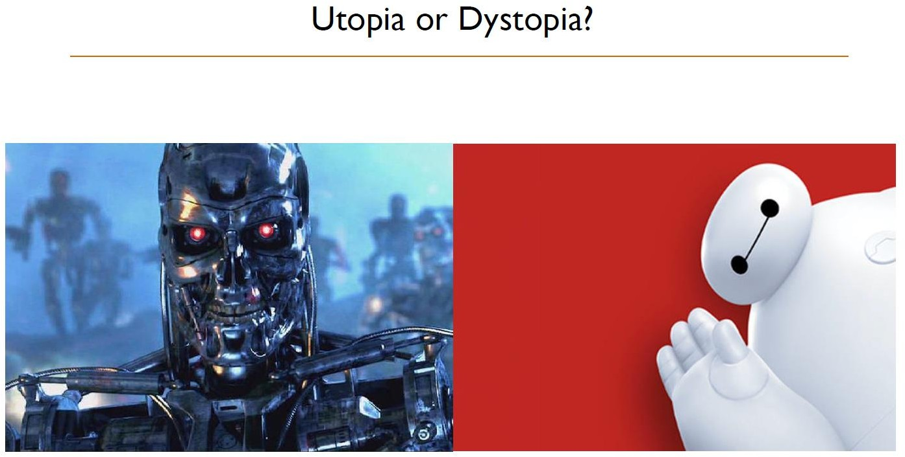

Slide 47
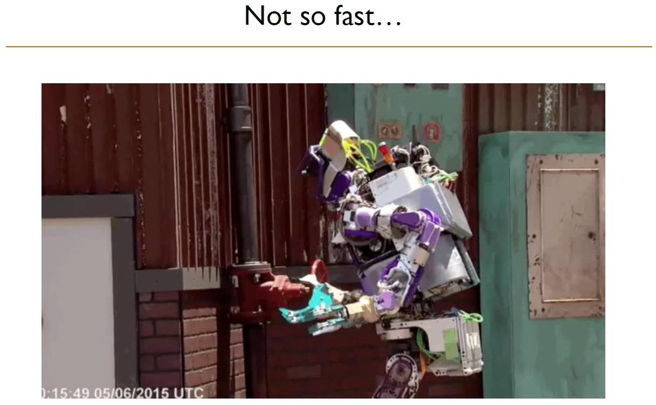

Slide 48
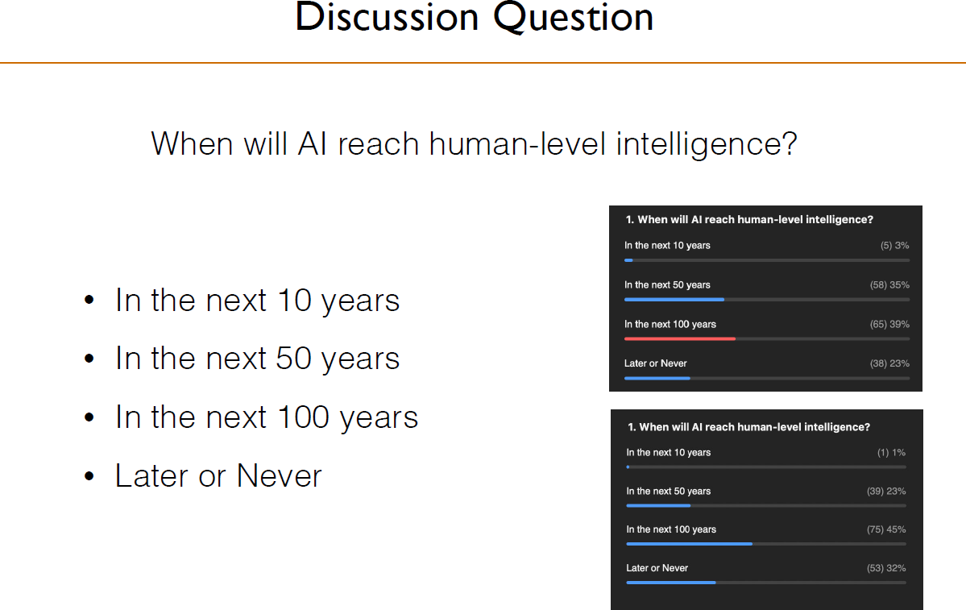

Slide 49
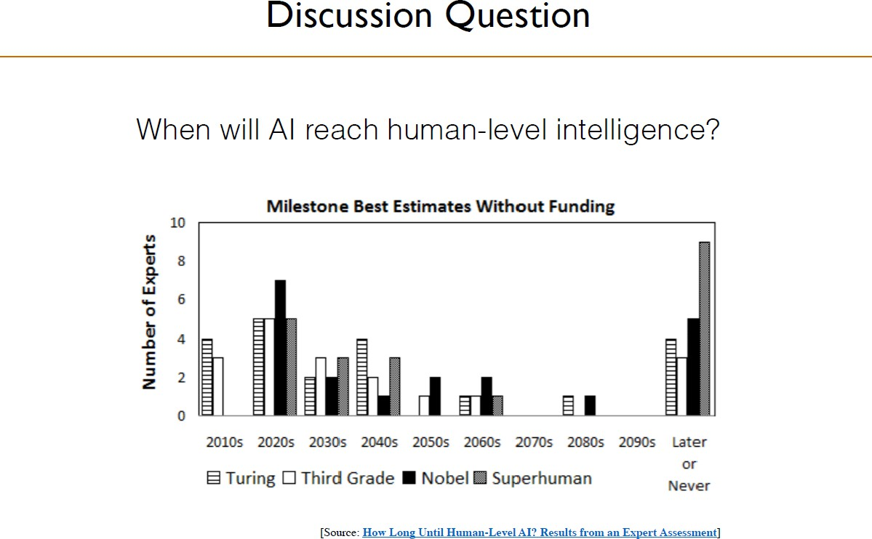

Slide 50
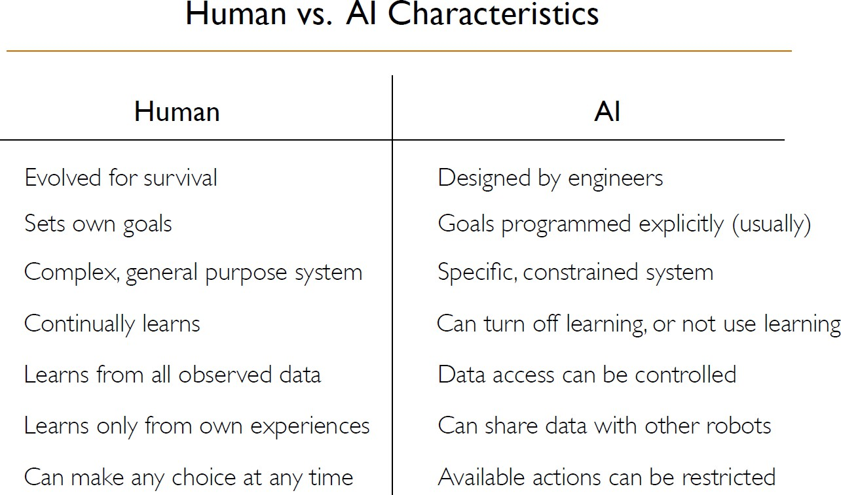

Slide 51
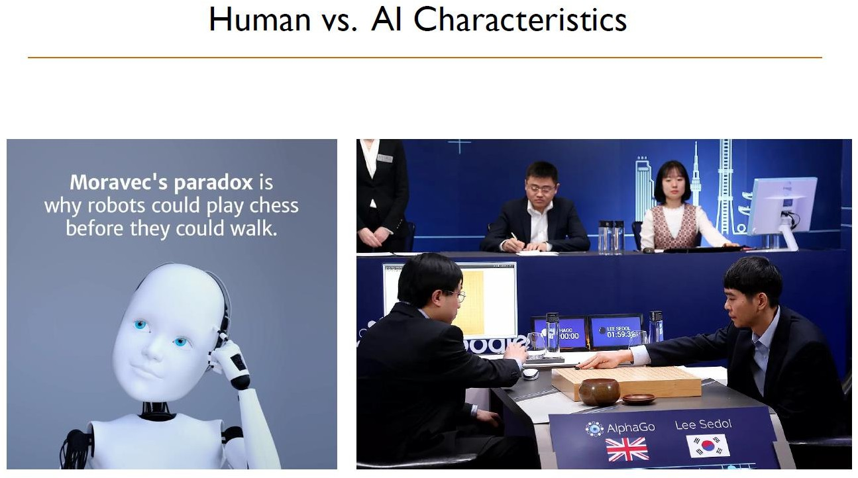

Slide 52
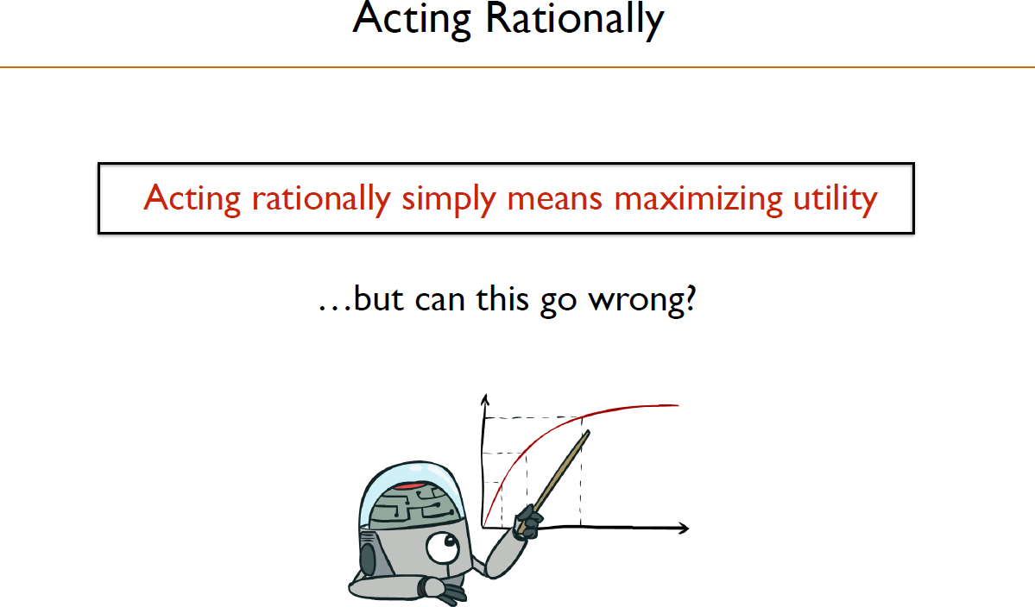

Slide 53
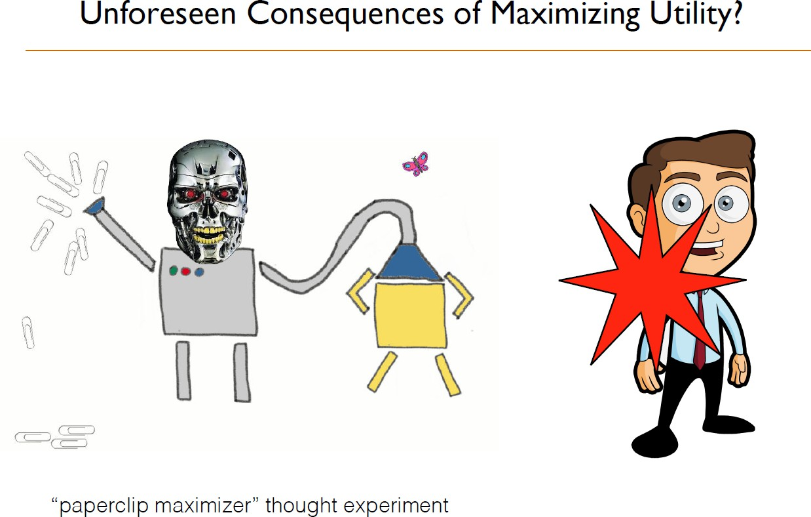
The scenario describes an advanced artificial intelligence tasked with manufacturing paperclips. If such a machine were not programmed to value human life, given enough power over its environment, it would try to turn all matter in the universe, including human beings, into paperclips or machines that manufacture paperclips.

Slide 54
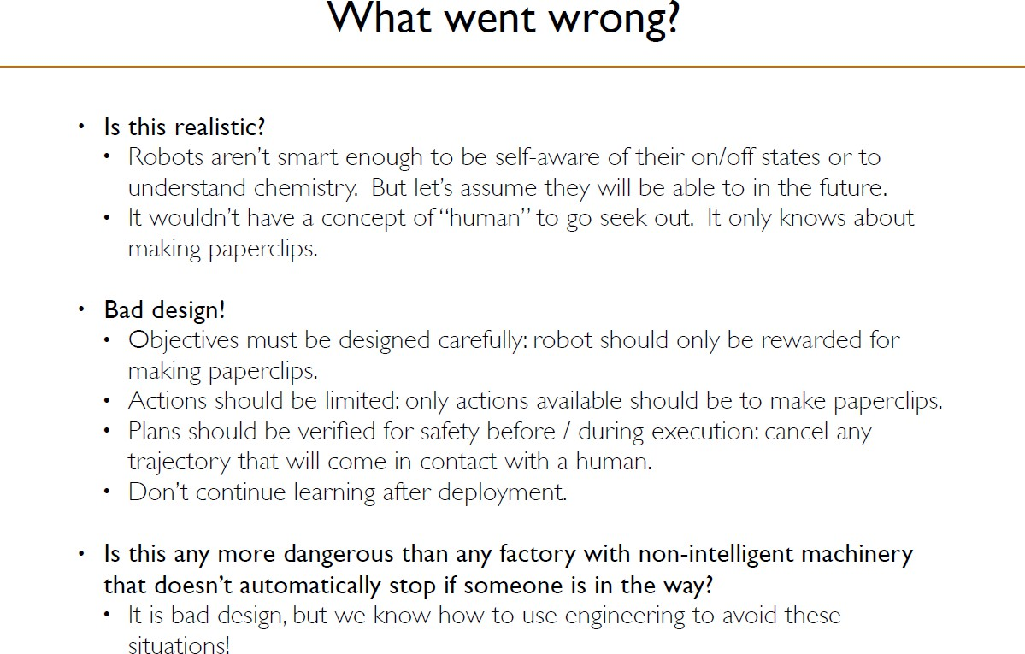

Slide 55
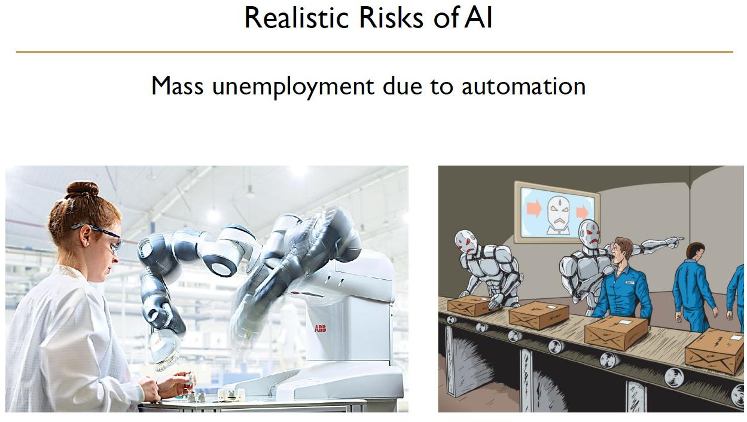

Slide 56
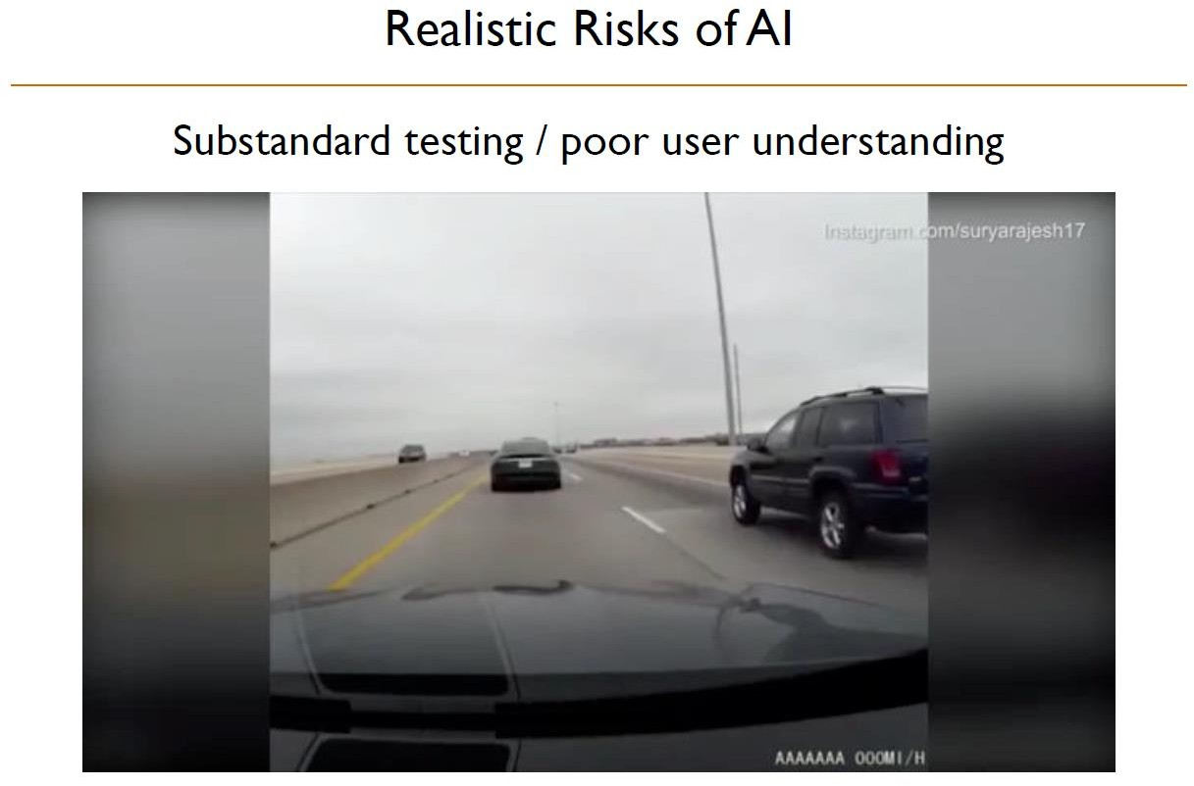

Slide 57
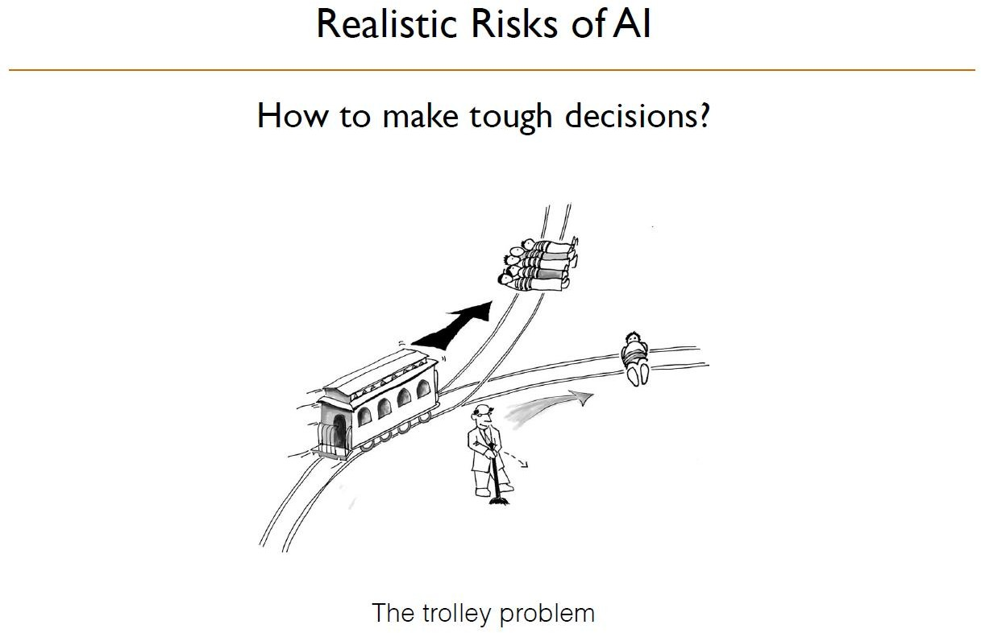

Slide 58
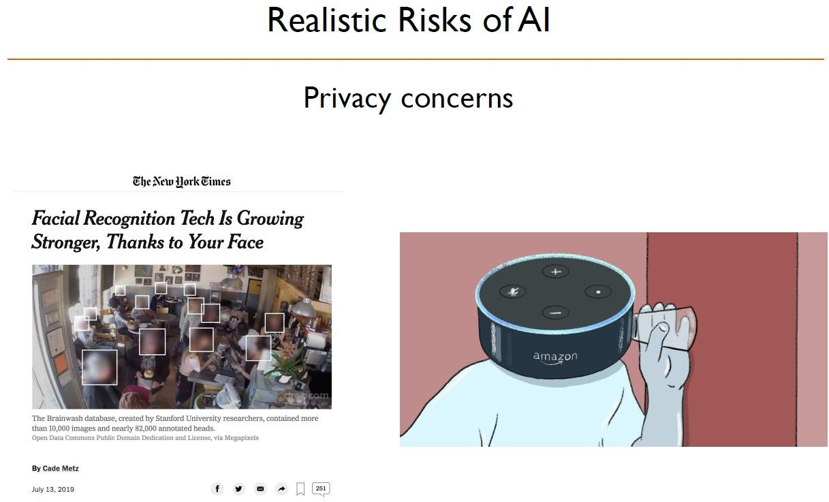

Slide 59
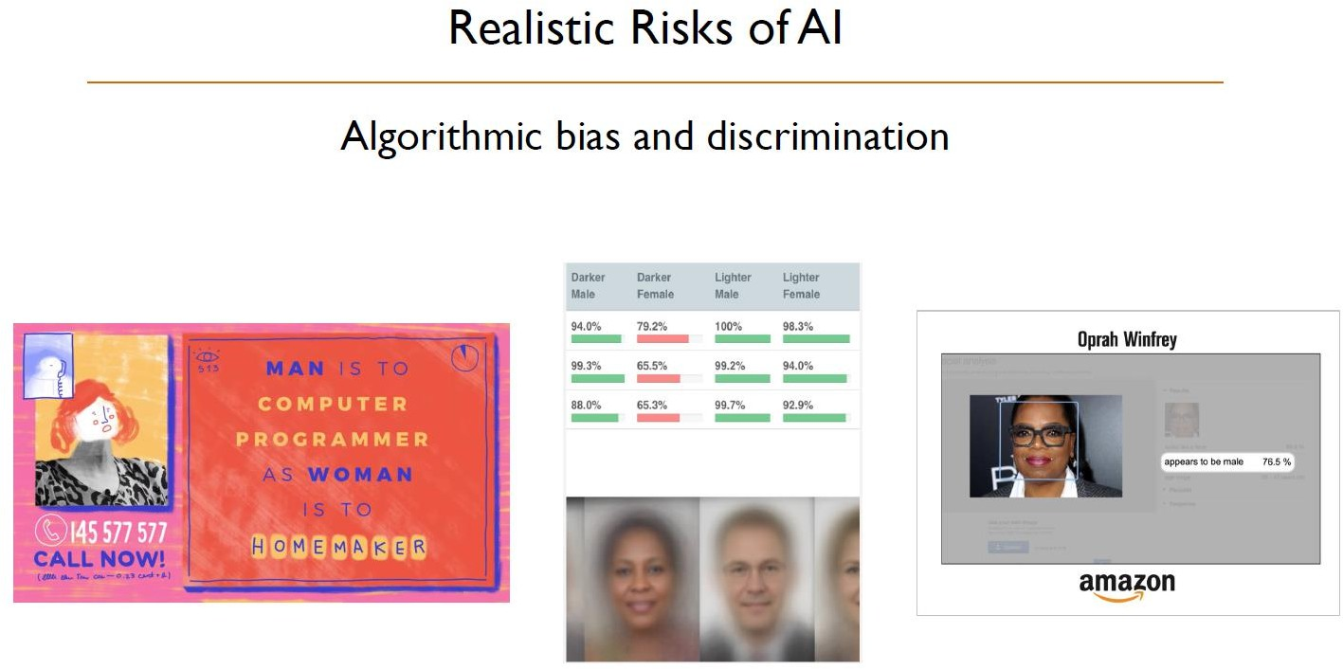

Slide 60
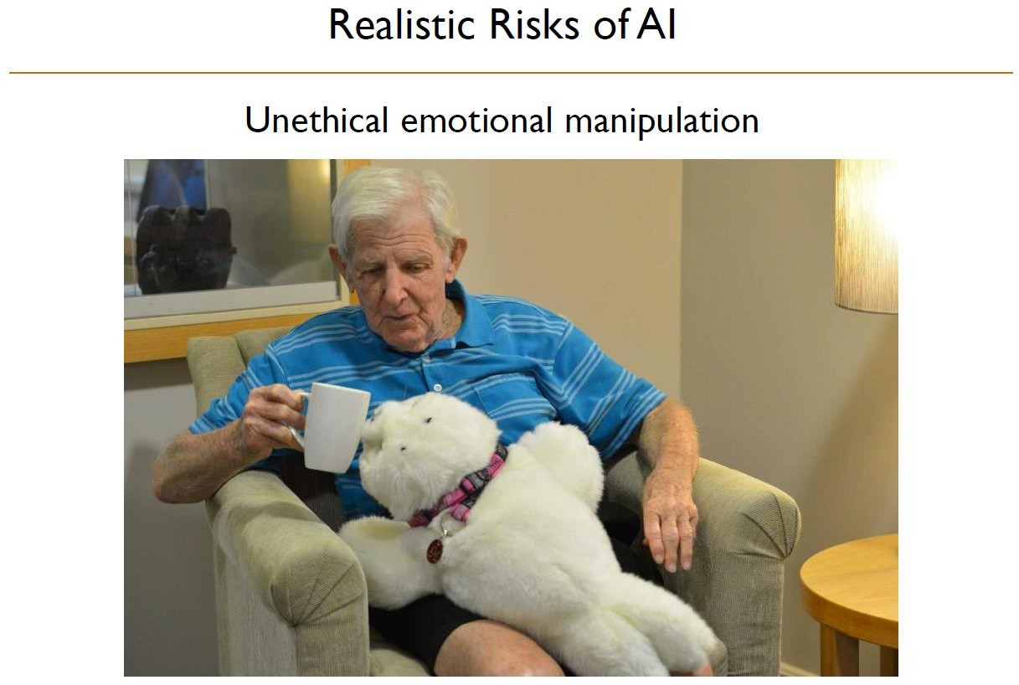

Slide 61
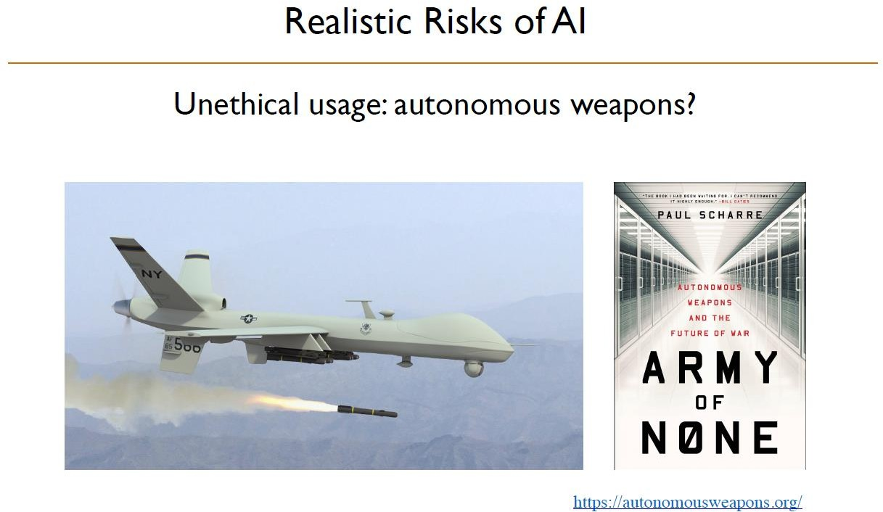

Slide 62
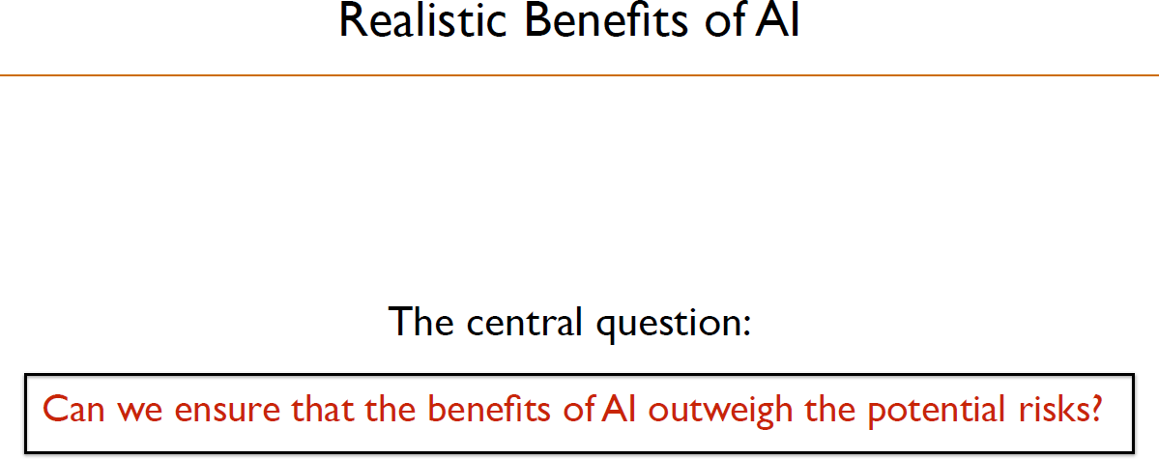

Slide 63
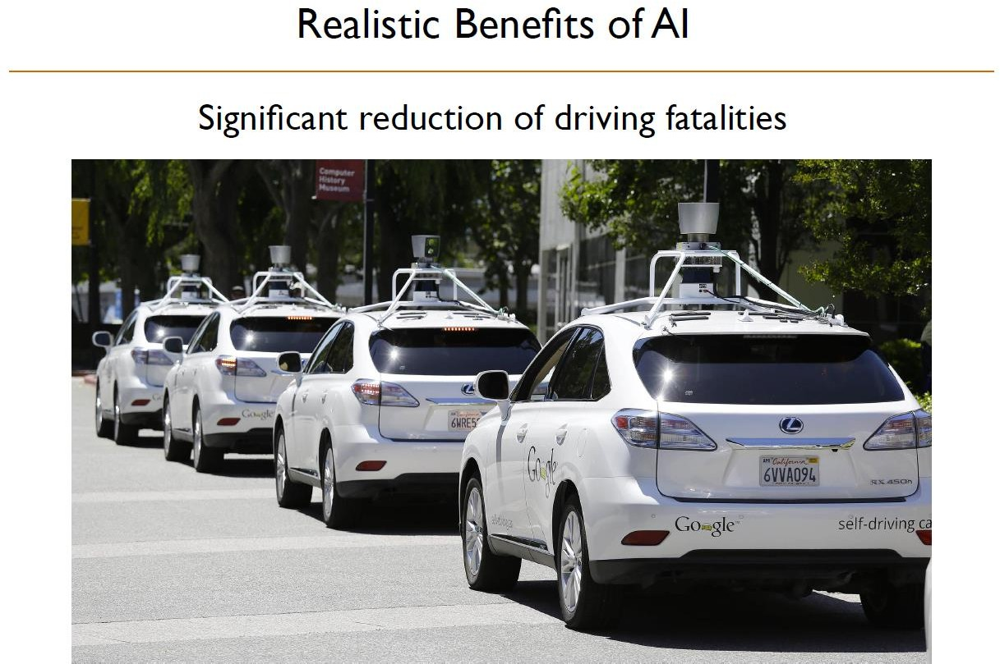

Slide 64
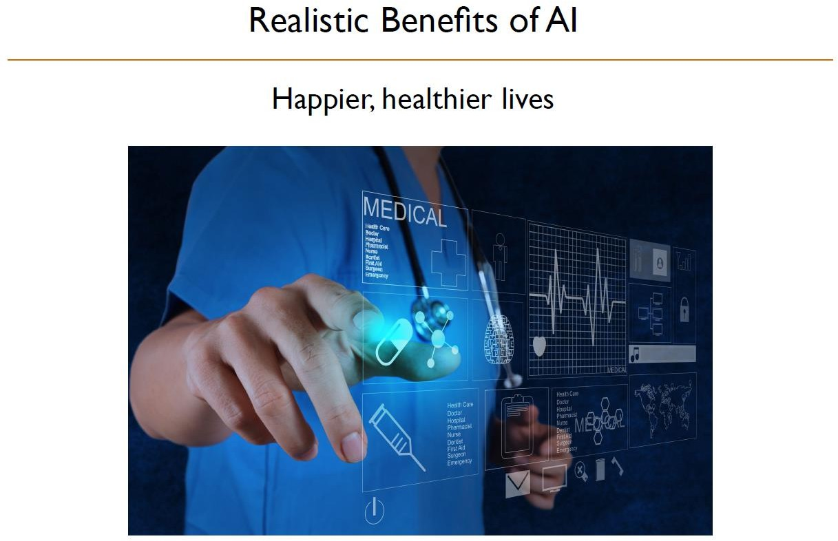

Slide 65
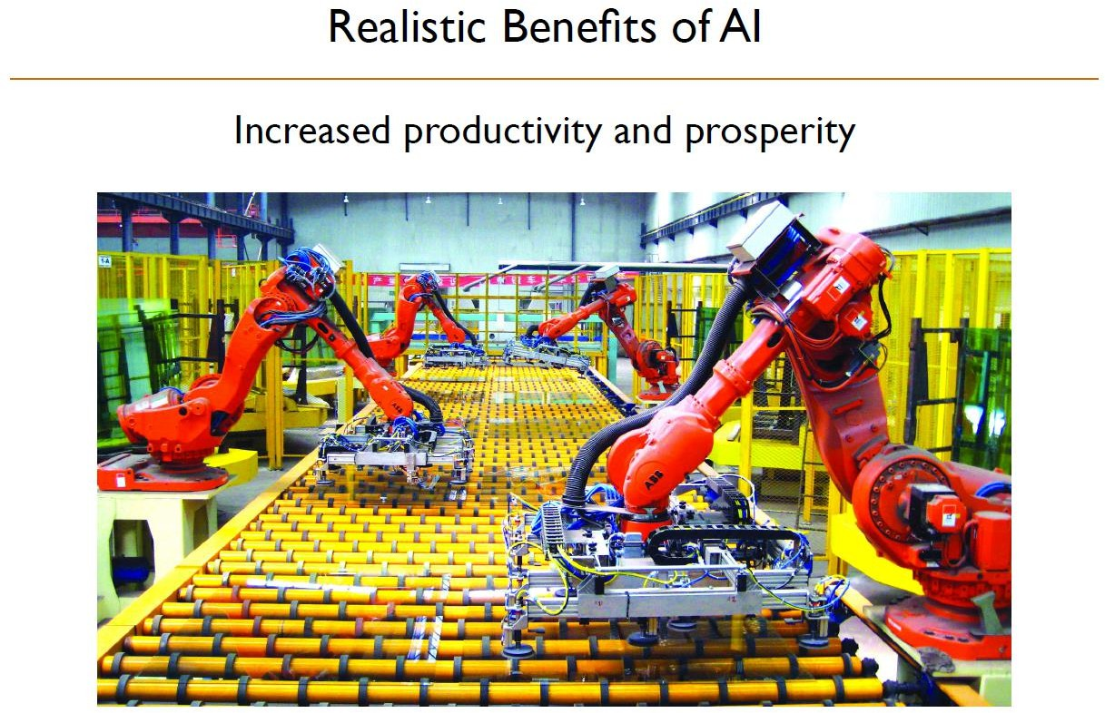

Slide 66


Slide 67


Slide 68


Slide 69


Slide 70


Slide 71


